Slide 1
Netflix Stock Analysis Using Python
An in-depth analysis of stock performance, identifying stock prices.

Slide 2
Project Objective
The objective of this analysis is to evaluate the stock performance of Netflix by analyzing key financial trends, identifying fluctuations in stock prices, and deriving meaningful insights using Python.

Slide 3
Data Cleaning
(Pandas & NumPy Library): Pandas was utilized for data manipulation, handling missing values, and structuring the dataset for effective analysis. NumPy was used for numerical computations, enabling efficient data processing and transformation.

Slide 4
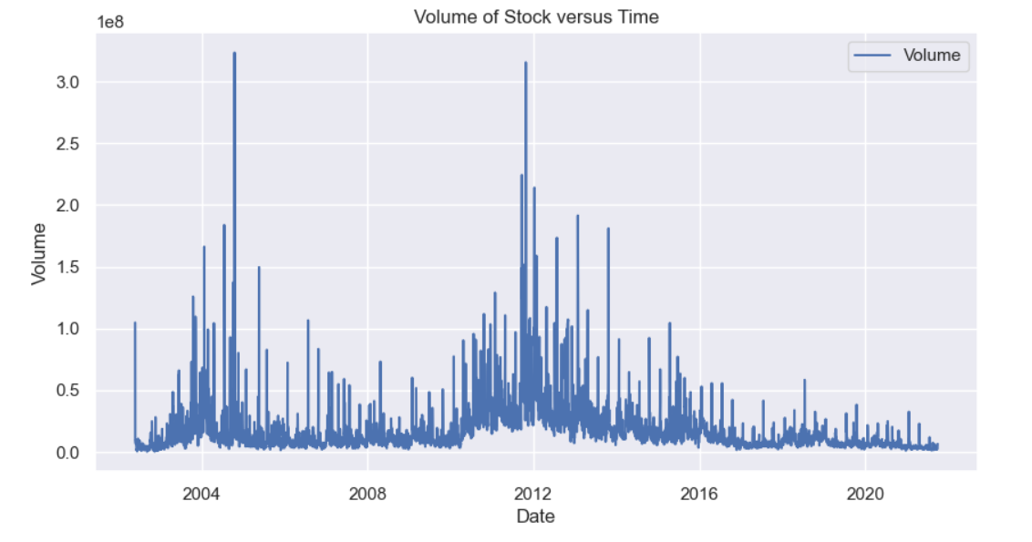
Data Analysis
➡️ Volume of Stock Traded:
✔ A comprehensive examination of the trading volume provides insights into investor interest and market activity concerning Netflix stock.

Slide 5
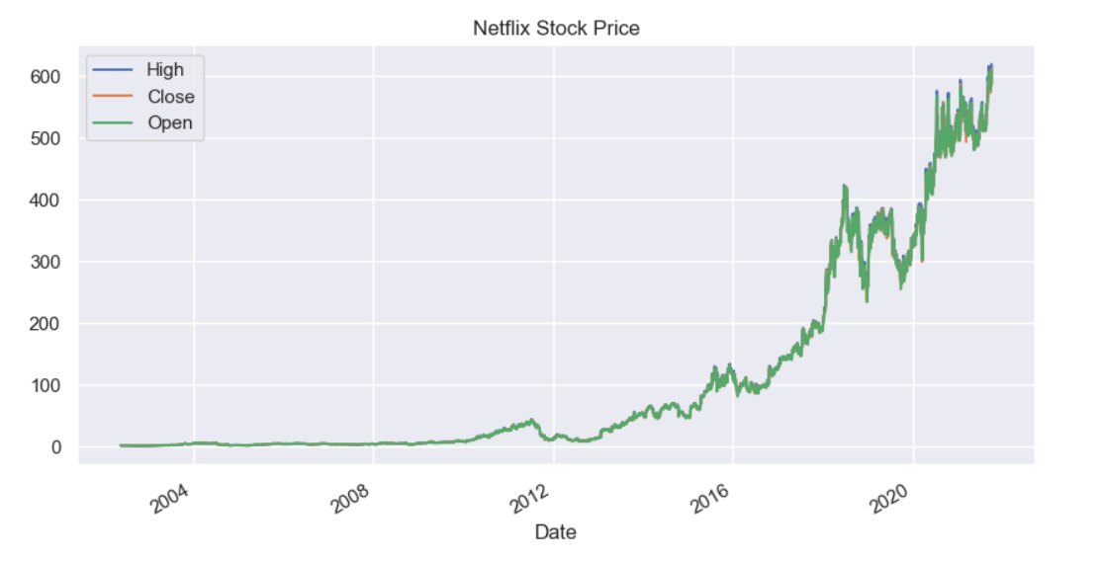
Data Analysis
➡️ Netflix Stock Price Trends (High, Open, Close):
✔ An analysis of high, open, and close prices helps track fluctuations in stock performance over time.

Slide 6
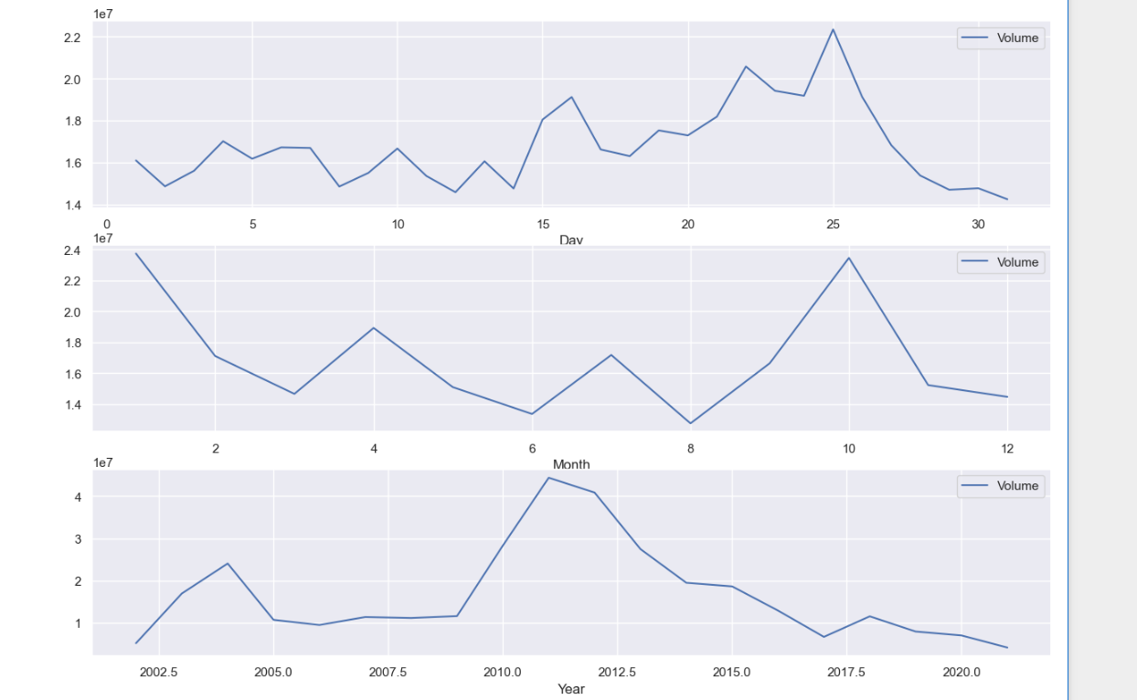
Data Analysis
➡️ Netflix Stock Price Analysis (Day, Month, Year Wise):
✔ Stock price variations across different timeframes provide insights into seasonality and long-term trends.

Slide 7
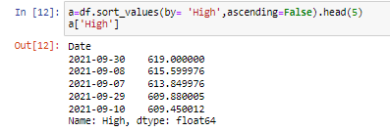
Data Analysis
➡️ Top 5 Dates with the Highest Stock Price:
✔ Identifying the highest stock price days helps understand market peaks and potential influencing factors.

Slide 8
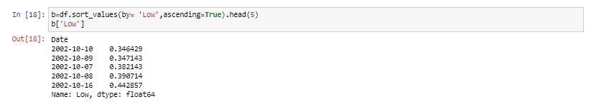
Data Analysis
➡️ Top 5 Dates with the Lowest Stock Price:
✔ Examining the lowest stock price days offers insights into market downturns and potential risk factors.

Slide 9
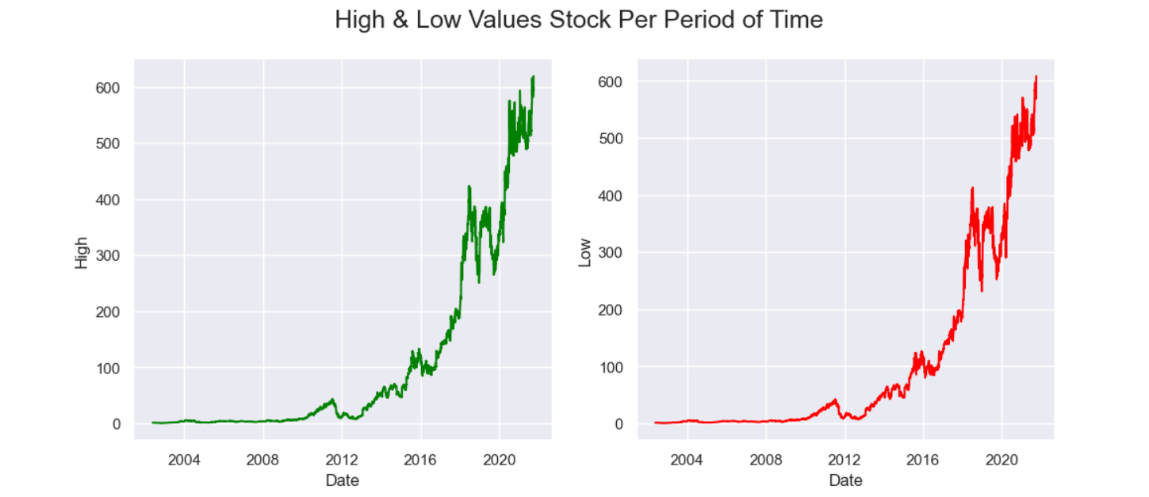
Data Analysis
➡️ High & Low Stock Prices Over Time:
✔ A comparative view of high and low stock prices per period provides a better understanding of volatility and risk.

Slide 10
Data Visualization
(Matplotlib & Seaborn Library): Matplotlib was used to generate detailed line and bar charts for stock price trends and trading volumes. Seaborn was leveraged to enhance visualization aesthetics and highlight patterns in stock performance.

Slide 11
Conclusion
✔ This analysis provides a data-driven understanding of Netflix's stock trends, identifying key trading patterns, high and low stock price dates, and trading volumes.

